Slide 1
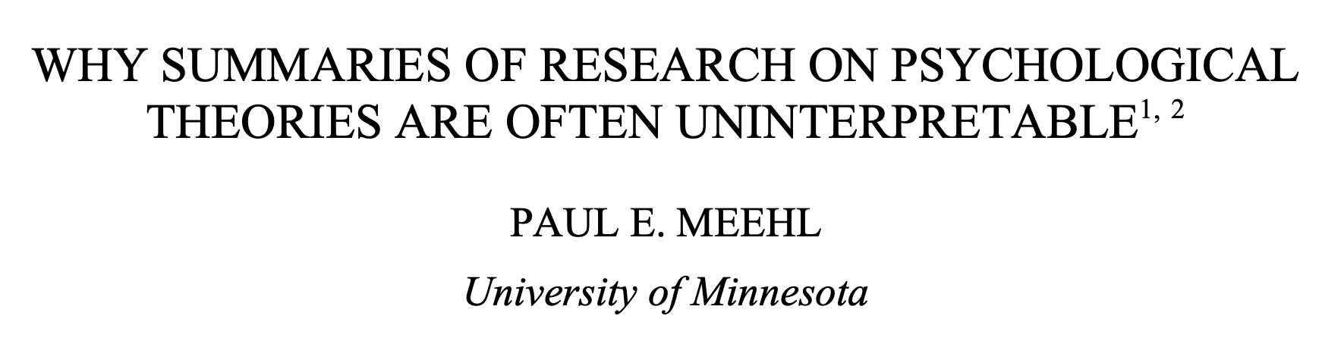
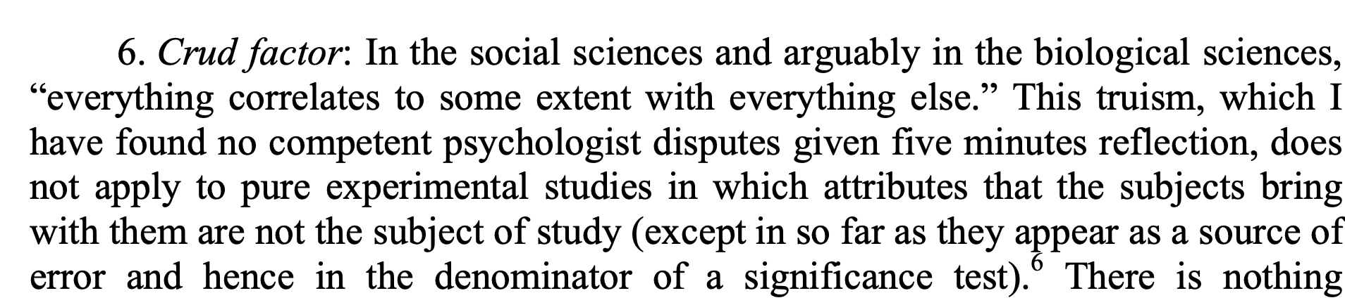

Slide 3
Why build models?

Slide 4
Why build models?
To help explain some empirical result
To help formulate a theory
Theoretical
Intuitions
Data
Analysis
Experiment
Model
Theoretical
Intuitions
Data
Analysis
Experiment
Model

Slide 5
Modeling approaches
Formal logic
Production systems (e.g SOAR, ACT-R)
Neural networks
Dynamic systems
Probabilistic models

Slide 6
Why build probabilistic models?
For us: probabilities are degrees of belief
Probability theory captures the right way to update degrees of belief
“The theory of probabilities is at bottom only common sense reduced to calculus; it makes us appreciate with exactitude that which exact minds feel by a sort of instinct without being able oft times to give a reason for it” (Laplace)

Slide 7
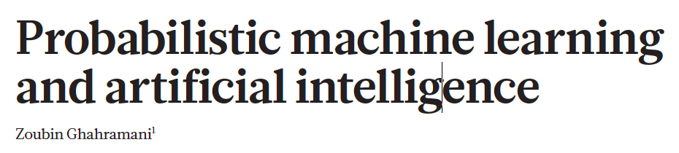
Applications of probability theory
Cognitive
Models
AI and
Machine
Learning
Data
Analysis

Slide 8
InDUCTIVE INFERENCE
Module 1

Slide 9

Inductive inference
Coughing friend

Slide 10
Inductive inference
John has a cold
Coughing friend

Slide 11
Inductive inference
John has emphysema
Coughing friend

Slide 12
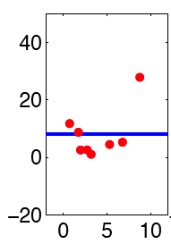
Inductive inference
Coughing friend
Curve fitting

Slide 13
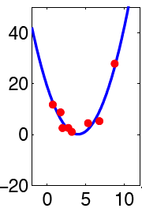
Inductive inference
John has a cold
Coughing friend
Curve fitting

Slide 14
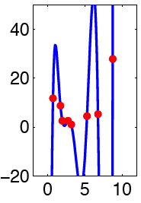
Inductive inference
John has emphysema
Coughing friend
Curve fitting

Slide 15
Curve fitting
D:
h₁: h₂: h₃:
P(h|d) α P(d|h) P(h)
Posterior
probability
Prior
knowledge
Evidence
Notes:
Sketch bar graphs on the board

Slide 16

Language
Causes
Objects
Number
Folk Physics
Light
Sound

Slide 17
Building a Bayesian model
What are the observed data?
What are the hypotheses?
What is the prior?
What is the likelihood?
Posterior
Likelihood
Prior
P(h|d) α P(d|h) P(h)

Slide 18
Take home messages
Bayesian models are useful for thinking about inductive problems.
There are many inductive problems from a wide range of domains including vision, language, motor control, etc.

Slide 19
Bayesian Networks (DIRECTED GRAPHICAL MODELS)
Module 3

Slide 20
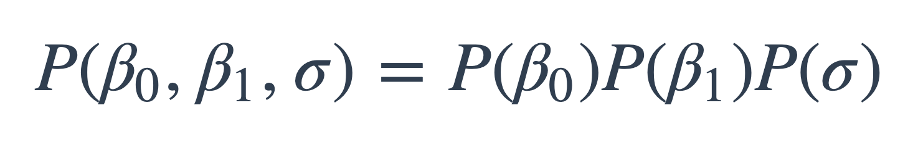
Representing hypothesis spaces and priors
Coughing patient:
we just enumerated the hypothesis space
Bayesian regression:
we assumed
What if the hypothesis space is huge – how do we come up with all the numbers in the prior?

Slide 21
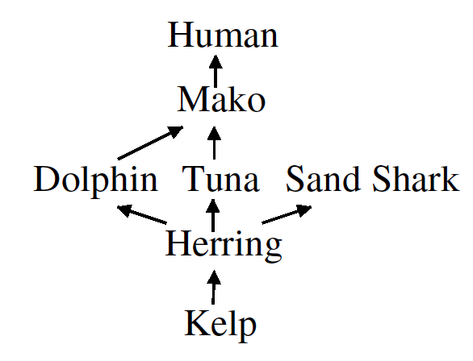
Food web problem
Herring carry a certain disease.
How likely is it that mako have the same disease?

Slide 22
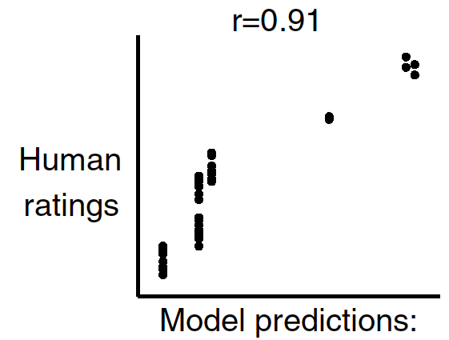
Food web problem
(Shafto et al, 2008)

Slide 23
Building a Bayesian model
What are the observed data?
What are the hypotheses?
What is the prior?
What is the likelihood?
Posterior
Likelihood
Prior
P(h|d) α P(d|h) P(h)

Slide 24
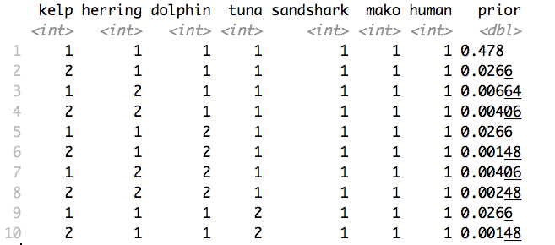
Hypothesis space and prior

Slide 25
Specifying a prior
Kelp
Herring
Dolphin
Tuna
Mako

Slide 26
Specifying a prior
Kelp
P(K = 1) = 0.1
Herring
Dolphin
Tuna
Mako

Slide 27
Specifying a prior
Kelp
P(K = 1) = 0.1
K | P(H = 1 |K)
0 | 0.1
1 | 0.55
Herring
Dolphin
Tuna
Mako

Slide 28
Specifying a prior
Kelp
P(K = 1) = 0.1
K | P(H = 1 |K)
0 | 0.1
1 | 0.55
Herring
Dolphin
Tuna
D | T | P(M = 1 |D, T)
0 | 0 | 0.1
0 | 1 | 0.55
1 | 0 | 0.55
1 | 1 | 0.775
Mako

Slide 29
Specifying a prior
Kelp
P(K, H, D, T, M) =
P(K) *
P(H|K) *
P(D|H) *
P(T|H) *
P(M|D,T)
Herring
Dolphin
Tuna
Mako

Slide 30
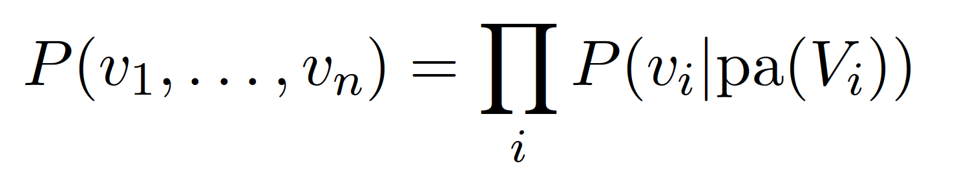
General formulation

Slide 31
Specifying a prior
Kelp
P(K = 1) = 0.1
K | P(H = 1 |K)
0 | 0.1
1 | 0.55
Herring
Dolphin
Tuna
D | T | P(M = 1 |D, T)
0 | 0 | 0.1
0 | 1 | 0.55
1 | 0 | 0.55
1 | 1 | 0.775
Mako

Slide 32
Specifying a prior
b: base rate
t: transmission rate
Kelp
P(K = 1) = b
K | P(H = 1 |K)
0 | b
1 | 1 – (1-t)(1-b)
Herring
Dolphin
Tuna
D | T | P(M = 1 |D, T)
0 | 0 | b
0 | 1 | 1 - (1-t)(1-b)
1 | 0 | 1 - (1-t)(1-b)
1 | 1 | 1 – (1-t)(1-t)(1-b)
Mako

Slide 33
Exercise: Food web (enumeration)

Slide 34
Take home messages
Bayes nets give us a good way to specify priors

Slide 35
INFERENCE BY SAMPLING FROM THE PRIOR
Module 4

Slide 36
Sampling from the prior
Kelp
P(K = 1) = 0.1
K | P(H = 1 |K)
0 | 0.1
1 | 0.55
Herring
Dolphin
Tuna
D | T | P(M = 1 |D, T)
0 | 0 | 0.1
0 | 1 | 0.55
1 | 0 | 0.55
1 | 1 | 0.775
Mako

Slide 37
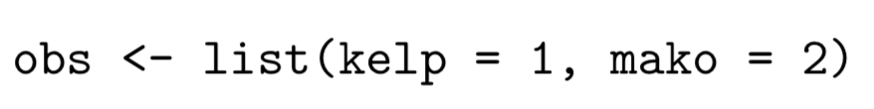
Sample based predictions
Collect set of samples from prior
Remove all those that are inconsistent with the observations
Make predictions based on samples that remain
Kelp
Herring
Dolphin
Tuna
Mako

Slide 38
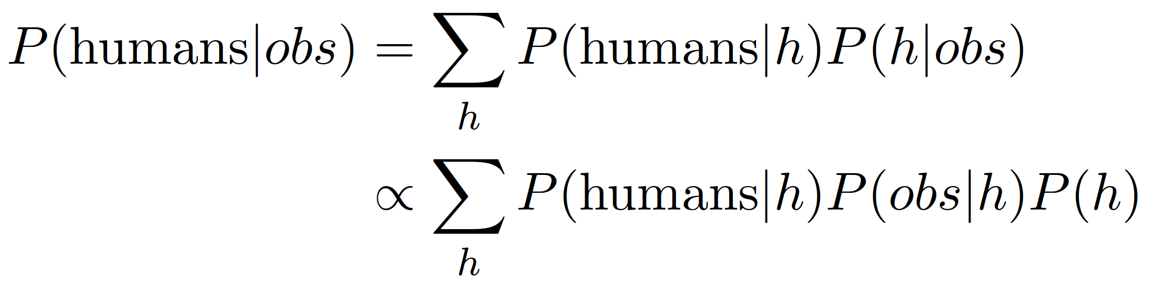
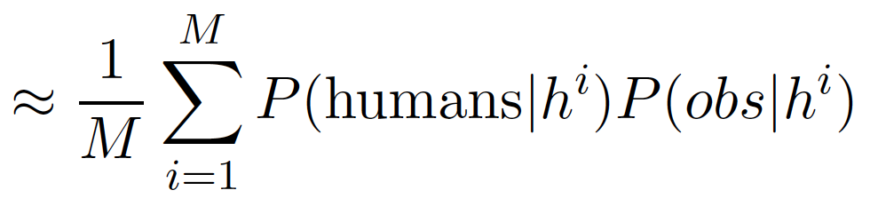
Sample based predictions

Slide 39
Exercise: Food web (sampling from the prior)

Slide 40
Take home messages
Bayes nets give us a good way to specify priors
Sampling is often a good way to implement probabilistic inference

Slide 41
JAGS
Module 5

Slide 42
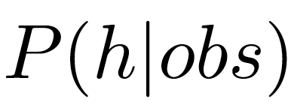
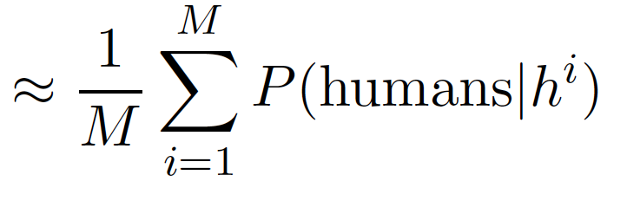
Sample based predictions
If we could sample from the posterior

Slide 43
JAGS and STAN
Widely used for data analysis and cognitive modeling

Slide 44
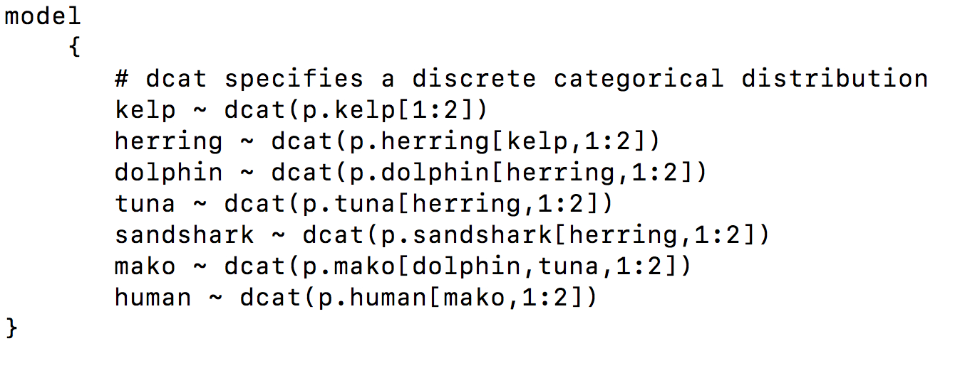
JAGS : model specification

Slide 45
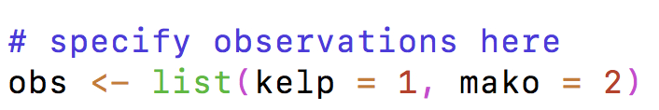
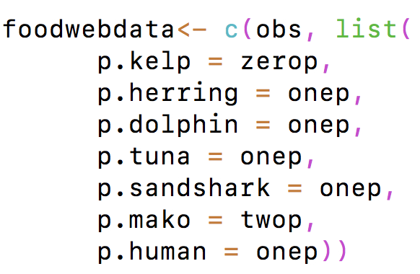
JAGS : observations and CPDs

Slide 46
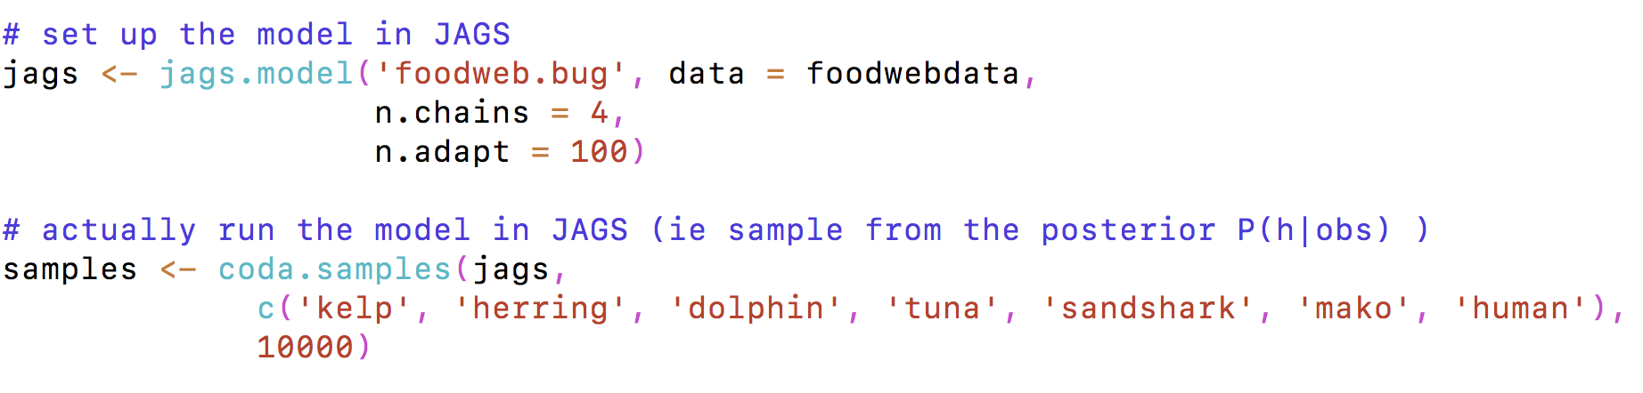
Running JAGS

Slide 47
Exercise: Food web (sampling from the posterior using JAGS)

Slide 48
Take home messages
Bayes nets give us a good way to specify priors
Sampling is often a good way to implement probabilistic inference
Tools like JAGS make sampling-based inference relatively simple in many contexts

Slide 49
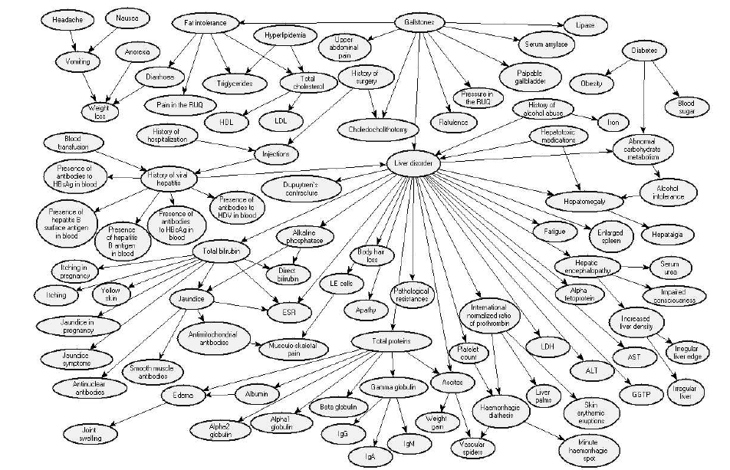
Medical diagnosis

Slide 50
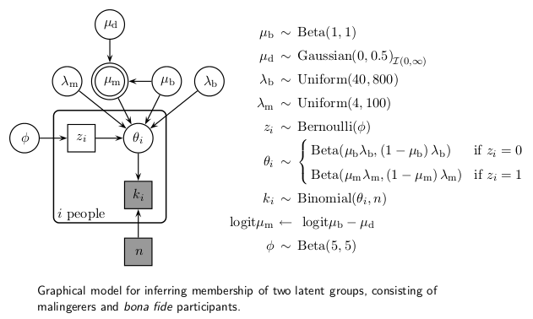
Bayes nets

Slide 51
Bayes nets
When you’re starting any modeling project
Try to write down the relevant variables
Draw a graph to show how the variables are related to each other

Slide 52
Bayes Nets and causal reasoning
Bayes nets support reasoning about:
Interventions
Counterfactuals

Slide 53
Take home messages
Bayes nets are:
a useful engineering tool
a tool for thinking

Slide 55
SAMPLING FRAMES AND SPHERES OF SODOR
Module 6

Slide 56
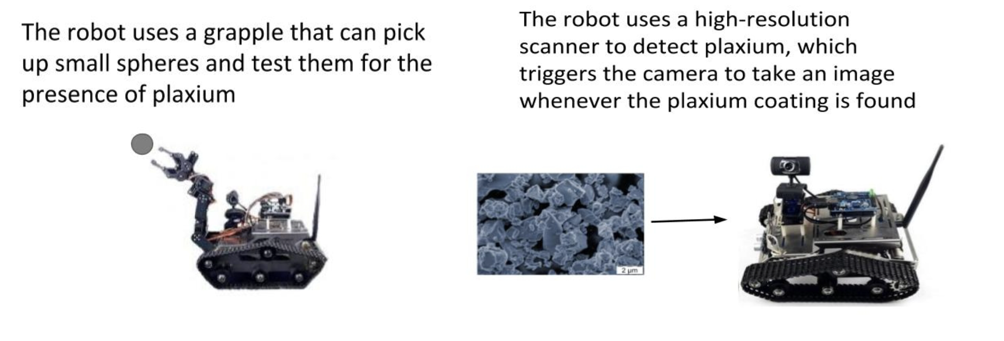
Sampling frames
Category sampling
Property sampling

Slide 57
Human data

Slide 58
Building a Bayesian model
What are the observed data?
What are the hypotheses?
What is the prior?
What is the likelihood?
Posterior
Likelihood
Prior
P(h|d) α P(d|h) P(h)

Slide 59
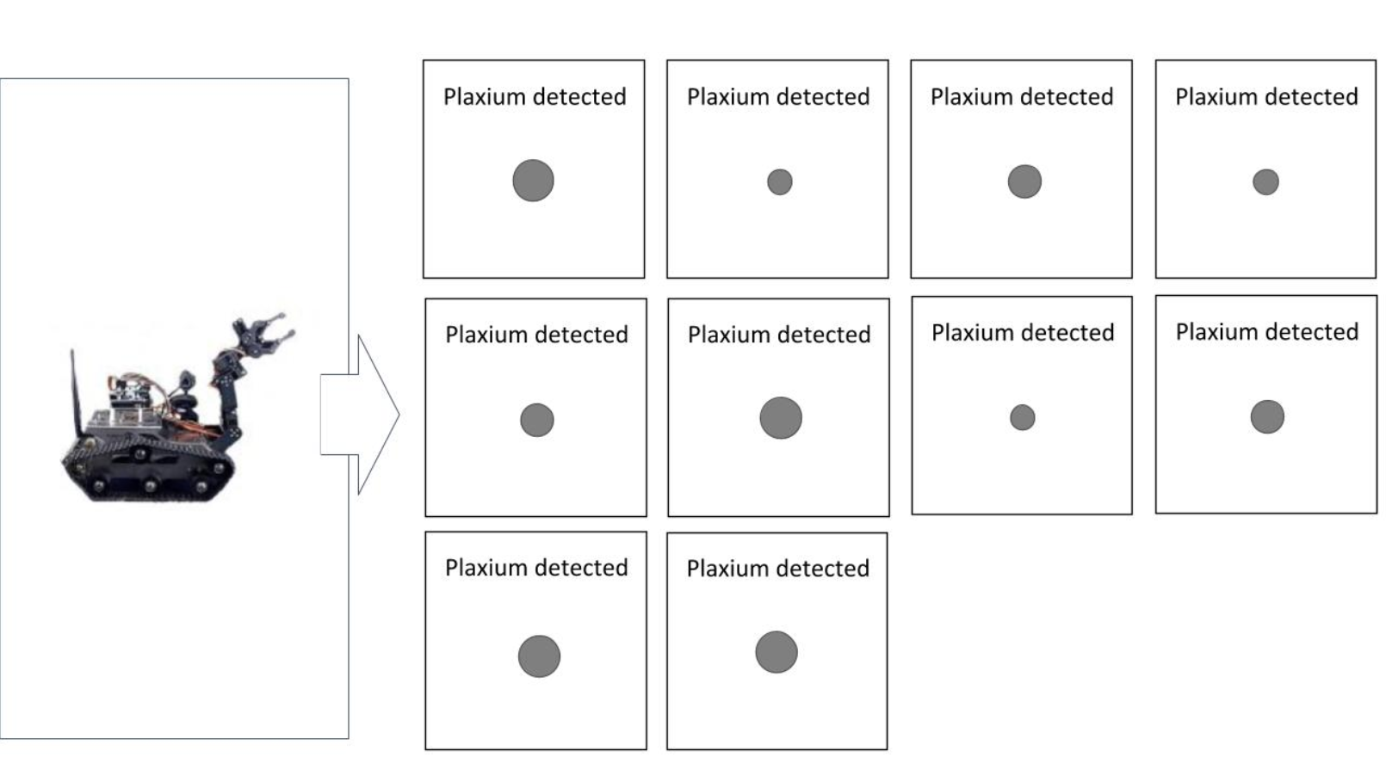
Observations

Slide 60
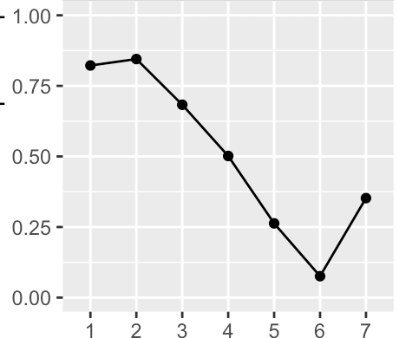

Hypotheses
category_means
Proportion with plaxium
category

Slide 61
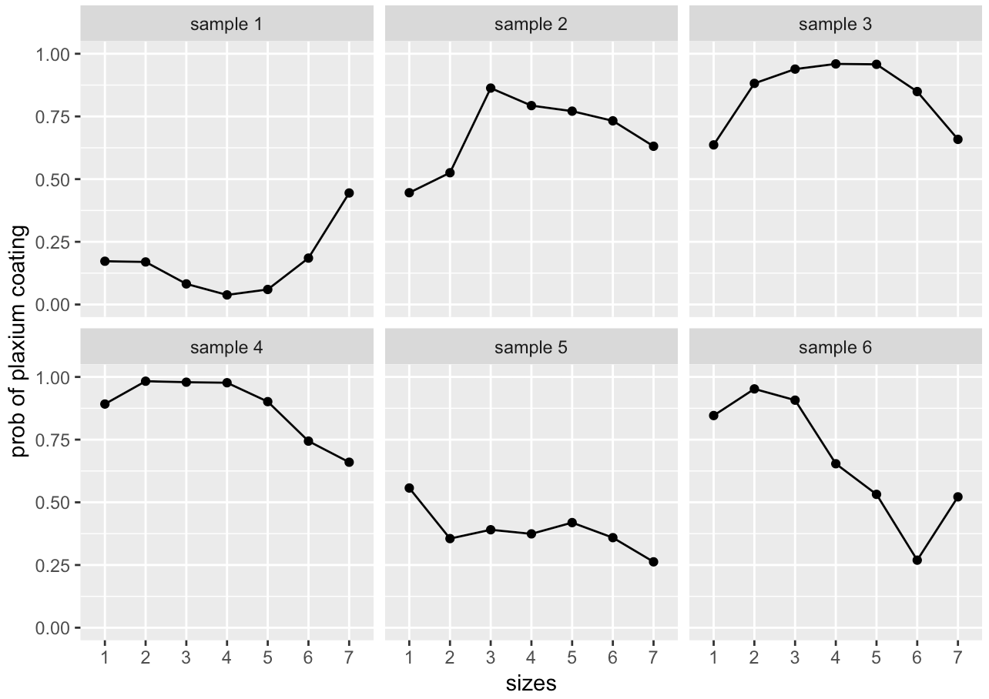
Prior on category means

Slide 62
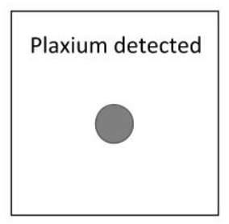
Category sampling
category_means
plaxium
category

Slide 63
Category sampling
mean_gp
category_means
plaxium
category

Slide 64
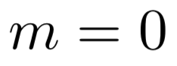
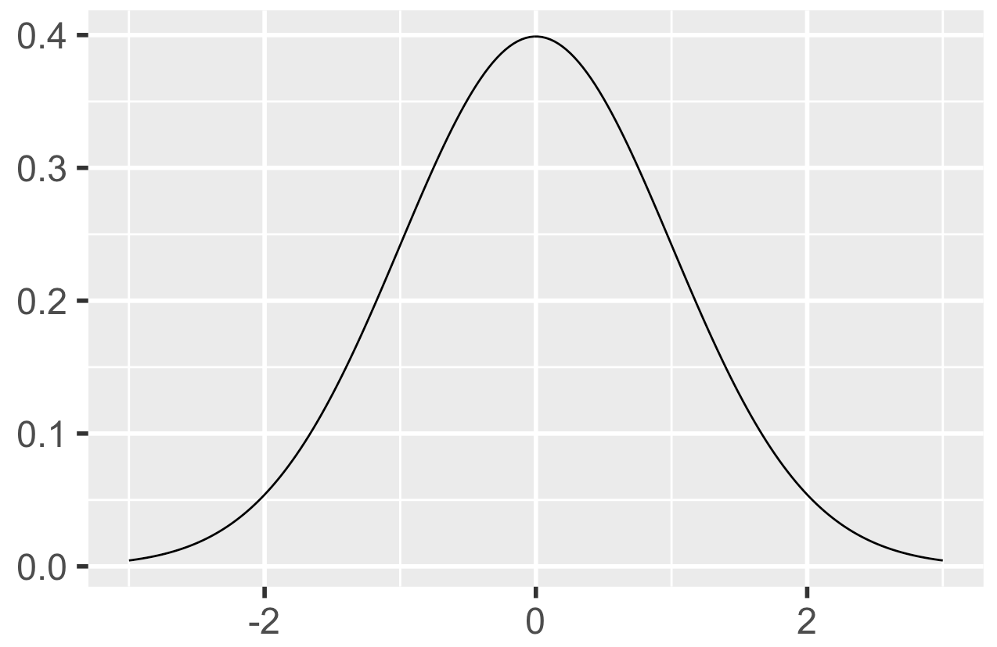
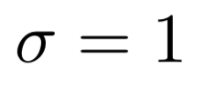
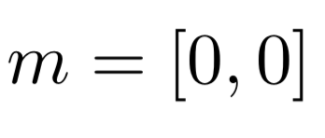
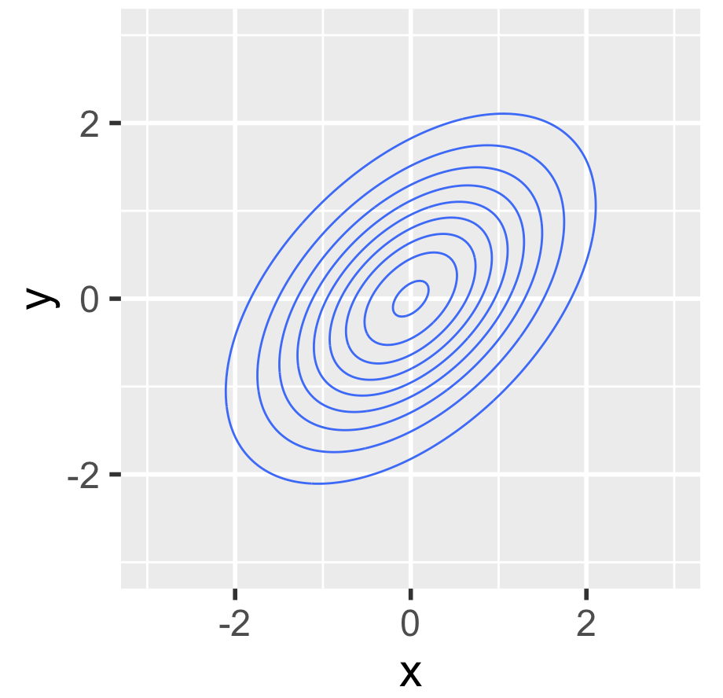
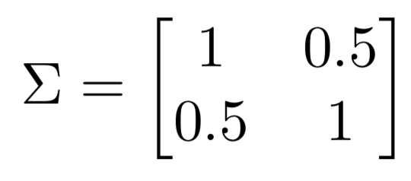
Gaussian distributions

Slide 65
Category sampling
m
cov_gp
mean_gp
category_means
plaxium
category

Slide 66
Category sampling
sigma
tau
rho
m
cov_gp
mean_gp
category_means
plaxium
category

Slide 67
Property sampling
category_means
base
plaxium
category

Slide 68
Property sampling
sigma
tau
rho
m
cov_gp
mean_gp
category_means
base
plaxium
category

Slide 69
Property sampling
sigma
tau
rho
m
cov_gp
mean_gp
alpha
category_means
base
plaxium
category

Slide 70
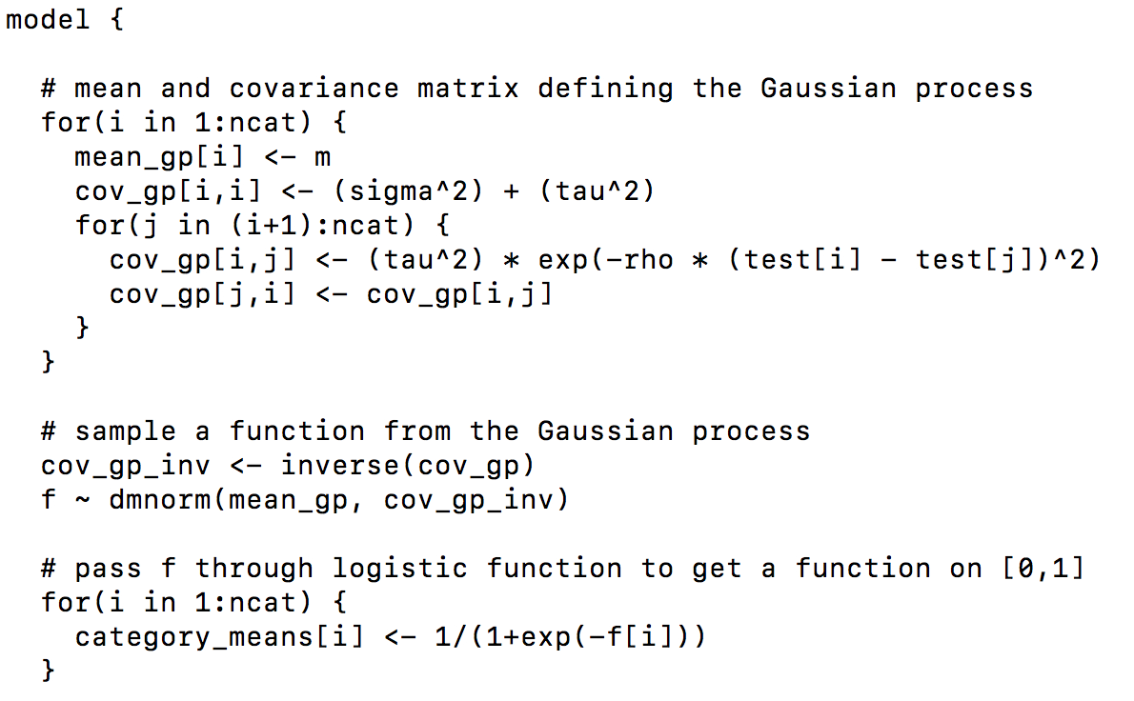
Inference with JAGS
Category sampling
category.bug
sigma
tau
rho
m
cov_gp
mean_gp
category_means
plaxium
category

Slide 71
Exercise: Sampling frames

Slide 72
Take home messages
Bayes nets let you build relatively complex models out of simple pieces
JAGS makes the implementation process relatively painless

Slide 73
TAKING STOCK

Slide 74
Today’s models
How are the models we’ve discussed useful?
And what are their limitations?

Slide 75
Bayesian models in general
Can Bayesian models be useful for thinking about problems you’re interested in?
Where might they be not so useful?

